Slide 1
Week 6
Alexey V. Zimin
JHU BME 580.417/707

Slide 2
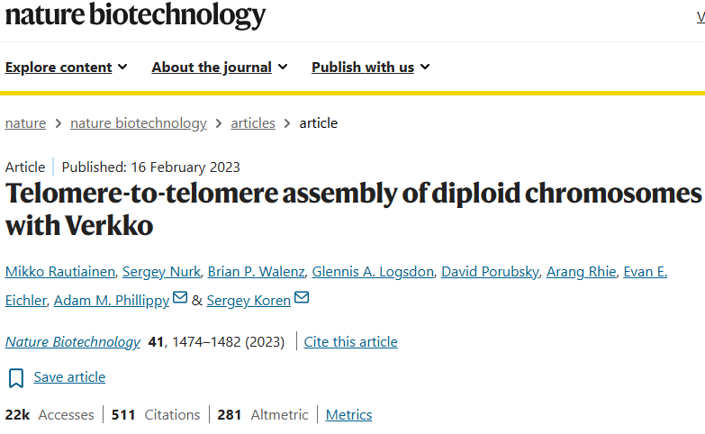
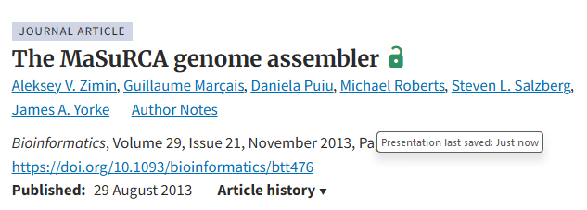
Genome assemblers that use DeBruijn graph or super-reads
Verkko – can produce T2T assemblies uses PacBio HiFi + Oxford Nanopore (ONT) data, high coverage requirements
MaSuRCA -- for hybrid data sets – uses both K-mer graph (super-reads) and OLC/String graph, requires Illumina reads, supports PacBio and ONT data

Slide 3
Scaffolding
Once you are done with contigs, you can scaffold
Scaffolding refers to a process of building scaffolds – ordered and oriented sets of contigs
We can use:
  Additional long reads
  Paired end reads
  HiC reads
Scaffold
NNNNNN

Slide 4
Scaffolding
Once you are done with contigs, you can scaffold
Scaffolding refers to a process of building scaffolds – ordered and oriented sets of contigs
We can use:
  Additional long reads
  Paired end reads
  HiC reads
Scaffolds are typically the final product of an assembly

Slide 5
Scaffolding
Building scaffolds typically involves building a graph of connected contigs
In a scaffold graph, each node usually denotes a contig, and each edge is a link between contigs
  Edge could (or could not) contain mutual orientation between contigs
  Edge could (or could not) contain distance between contigs
In constructing a scaffold graph, the most important issues are how to determine whether to add an edge between two contigs, and how to set the edge weights
The weight of an edge reflects the reliability of the edge. For example, one can use the number of linking read pairs as a weight

Slide 6





Scaffolding
One must also remember that a scaffold is a linear structure:

Slide 7



Scaffolding
One must also remember that a scaffold is a linear structure:
Can use greedy approach:
  choose the highest weight edge
  keep adding edges unless there is a conflict (e.g. two non-overlapping contigs on top of each other)

Slide 8
Scaffolding
One must also remember that a scaffold is a linear structure:

Slide 9
Scaffolding algorithm
Produce file containing five columns:
scaffold1 scaffold2 weight distance orientation
…
Make sure the “distance” does not place scaffolds on top of each other in any line
Sort by weight
Use greedy algorithm: choose the line with the highest weight, record the merge
Choose the line with the next highest weight and merge…etc.

Slide 10
Scaffolding with HiC data
Pairs or reads: random orientations, unknown distances

Slide 11
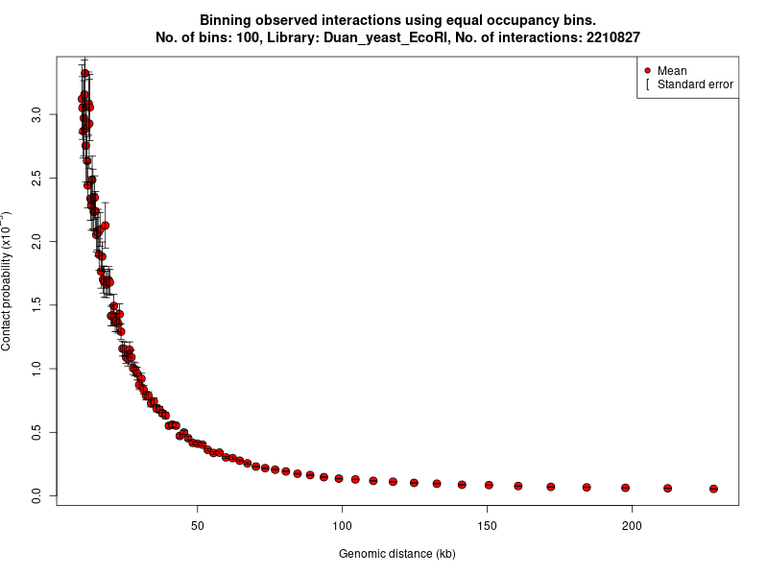
Hi-C scaffolding: why it works?
Contig 1
Contig 2
Many contacts (links) == nearby
Few contacts (links) == far away
Image from: https://www.bioconductor.org/packages/release/bioc/vignettes/FitHiC/inst/doc/fithic.html

Slide 12
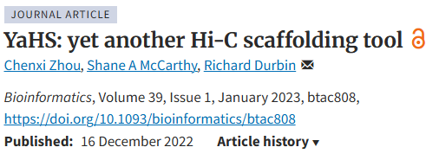
YaHS scaffolder
YaHS (Yet another HiC Scaffolder)
  Very lightweight and easy to use
  Input aligned HiC reads (bam) and assembly

Slide 13
Errors in genome assemblies
Repeats in the genome and errors in the reads cause errors
Large scale structural errors:
  Chimeric contigs, contain two sequences erroneously merged
  Insertions or deletions (e.g. wrong number of repeat copies)
Small scale errors
  Insertions or deletions of up to 5-10 bases
  Substitutions

Slide 14
Assembly post-processing
Detection and correction of structural errors
Premise: assembly must be consistent with the reads
Assemblers typically just output contigs, they do not report how these contigs were built from the reads
Once way to evaluate for structural errors is to align the original reads to the assembled contigs and compute the coverage
  Use a single alignment for each read (--secondary=no for minimap)

Slide 15
Assembly post-processing
Detection and correction of structural errors
1-2x coverage in the middle of a contig is always suspicious
  Must confirm with other evidence

Slide 16
Using K-mers to find errors
All K-mers in the assembly should the present in the reads
  It is possible in low-coverage regions for a K-mers in assembly to not be found in any of the reads:
  AGATAGACATAGACATAGACAGG
  AGATAGACAAAGACATAGACA
  ATAGACATAGACAAAGCAG
  AGAAATAGACATAGACA
  However, such cases are rare and thus they should be examined
K-mers in the reads that are around the mean coverage must be present in the assembly

Slide 17
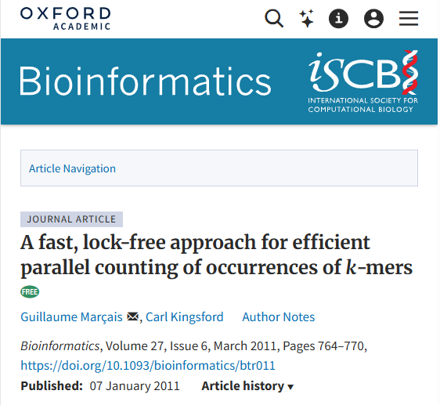
How to count K-mers
Jellyfish is a versatile tool
  Fast (multi-threaded)
  Space-efficient
  Based on CAS (compare and swap) compares the contents of a memory location with the previous value and, only if they are the same, modifies the contents of that memory location to a new given value
C++ library
Perl, Ruby and Python bindings
  Can load and query k-mer counts database from these languages

Slide 18
Canonical kmers
AGCATGATGA
TCATCATGCT

Slide 19
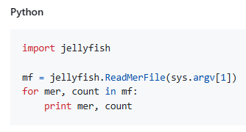
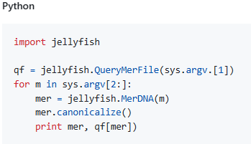
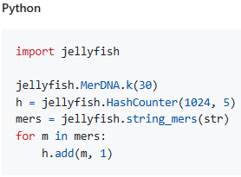
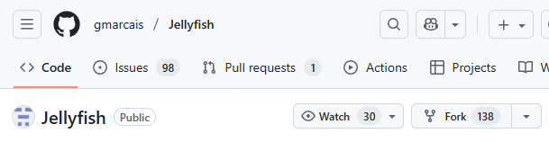
Python binding
Allows to load, query database
Jellyfish dump Jellyfish query Jellyfish count

Slide 20
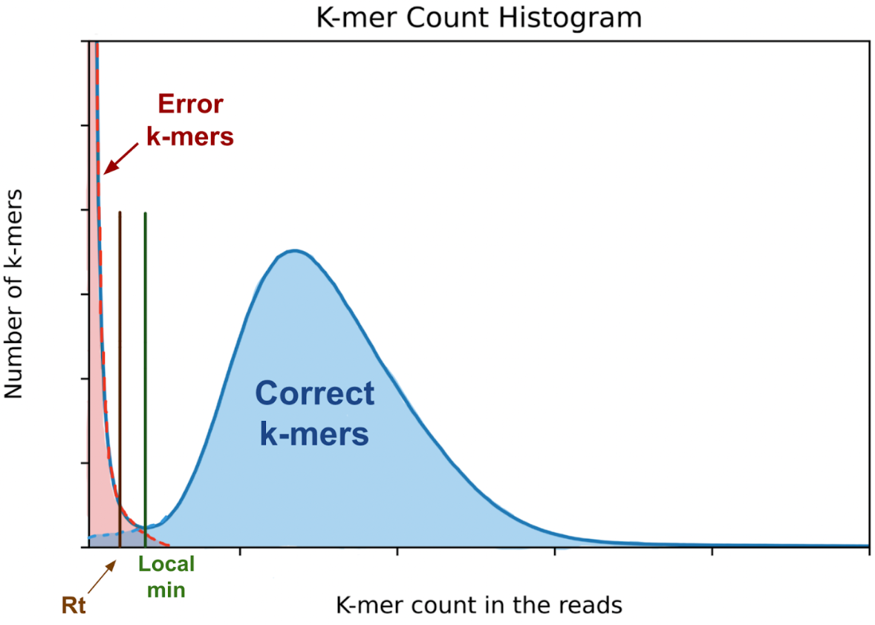
K-mer count histogram
Count occurrences of all K-mers in the reads (jellyfish count)
Bin the counts and plot histogram of how many K-mers have counts that fall into each bin (jellyfish histo)
Choose threshold
K-mers that occur in the reads with counts > threshold must be in the assembly
Can use this technique to estimate genome size as
(# of correct K-mers)/(K-mer coverage)
~Exponential distribution
K-mer coverage
Negative binomial distribution

Slide 21
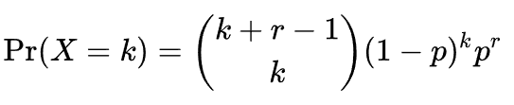


K-mer count histogram
Negative binomial distribution,
Binomial coefficient:
Mean
~Exponential distribution
K-mer coverage
Negative binomial distribution

Slide 22
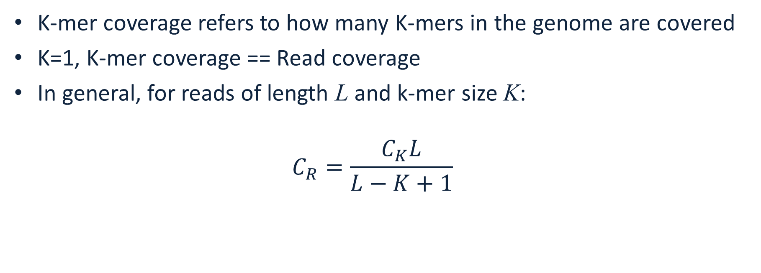
K-mer coverage vs Read coverage
K-mer coverage refers to how many K-mers in the genome are covered
K=1, K-mer coverage == Read coverage
In general, for reads of length L and k-mer size K:
$C_{R}=\frac{C_{K}L}{L−K+1}$

Slide 23
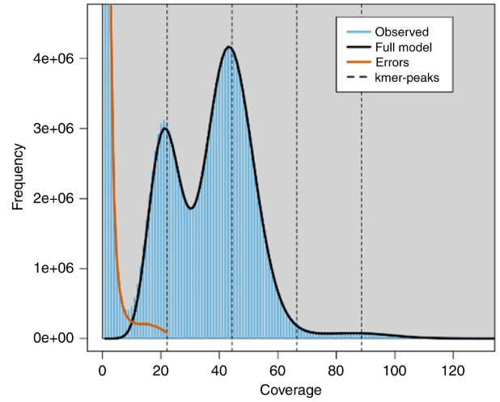
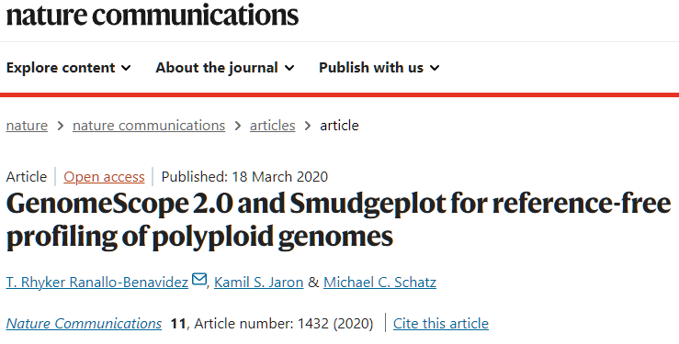
Challenge
What does this histogram tell us:
Pair of chromosomes, one from each parent:
44x
22x
44x
Image credit:

Slide 24
GenomeScope
Genomescope is a program developed at JHU by T. Rhyker Ranallo-Benavidez, Kamil S. Jaron, and Michael C. Schatz
Web-based interface: http://genomescope.org/genomescope2.0/ (note: https://genomescope.org/genomescope2.0/ does not work)
Compute k-mer count database with jellyfish
Output histogram of counts with “jellyfish histo”, save in a file
Upload the histogram to GenomeScope
DEMO

